Slide 1
Worship Conversation

Slide 2
Two Opinions
One Service
Two Services
1) Not enough members to sustain two services
2) More full feeling
3) More unified, build relationships
1) Don’t want to lose 10% attendance
2) Variety of styles each Sunday
3) Different times provide better opportunities

Slide 3
Questions:
What combination of worship services and times will help us grow as a congregation?
What combination of worship services and times will help us accomplish our mission?

Slide 4
QUESTIONS determine your RESULTS

Slide 5
Questions Determine Results
Questions
Decisions
Actions
Results

Slide 6
Fuller Institute And US Census Bureau
1980’s → 10% drop in membership
1990’s → 12% drop in membership
Over 4,000 church close each year
2.7 Million become inactive each year
Of entire US population
22% attended frequently in 1995
19% 1999
18% 2002

Slide 7
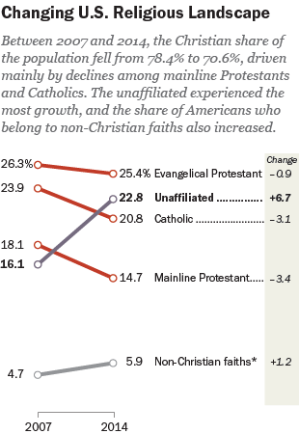
Pew Research

Slide 8
ELCA Stats
In 2007 2% US population were ELCA members
Dropped to 1.4% by 2014
Total decline in ELCA membership = 30%

Slide 9
Southeastern Iowa Synod Stats
From 2011-2016
1.4% drop active members
1.7% drop average worship attendance
From 2014-2016 → 70% of congregations decline in membership by more than 3%

Slide 10
Grace Lutheran Muscatine
From 2009-2016 → decline in active membership = 6.5%

Slide 11
Technical vs. Adaptive Problems
Technical
Adaptive
Have all info needed
Solution clear
Solved quickly
Minimal change
Ex: leaking pipe
Don’t have all info needed
Answers not clear
Long time to solve
A lot of change
Ex: Alzheimer’s

Slide 12
“the process by which the Gospel transforms my life—thoughts, words, actions”
Faith Formation

Slide 13
New Question:
How do our worship practices form faith?

